Slide 1
Android Security
Exploiting the Vulnerabilities

Slide 2
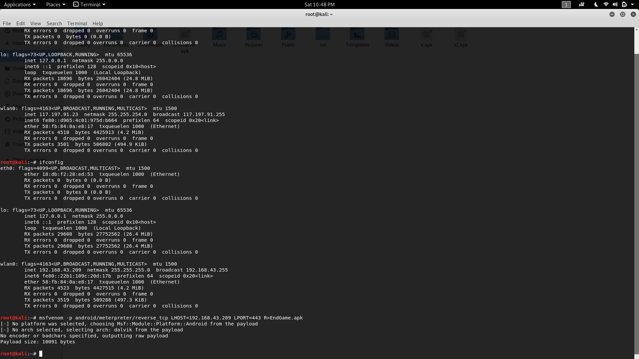
Creation of Malicious Payload
Metasploit is used for the creation.

Slide 3
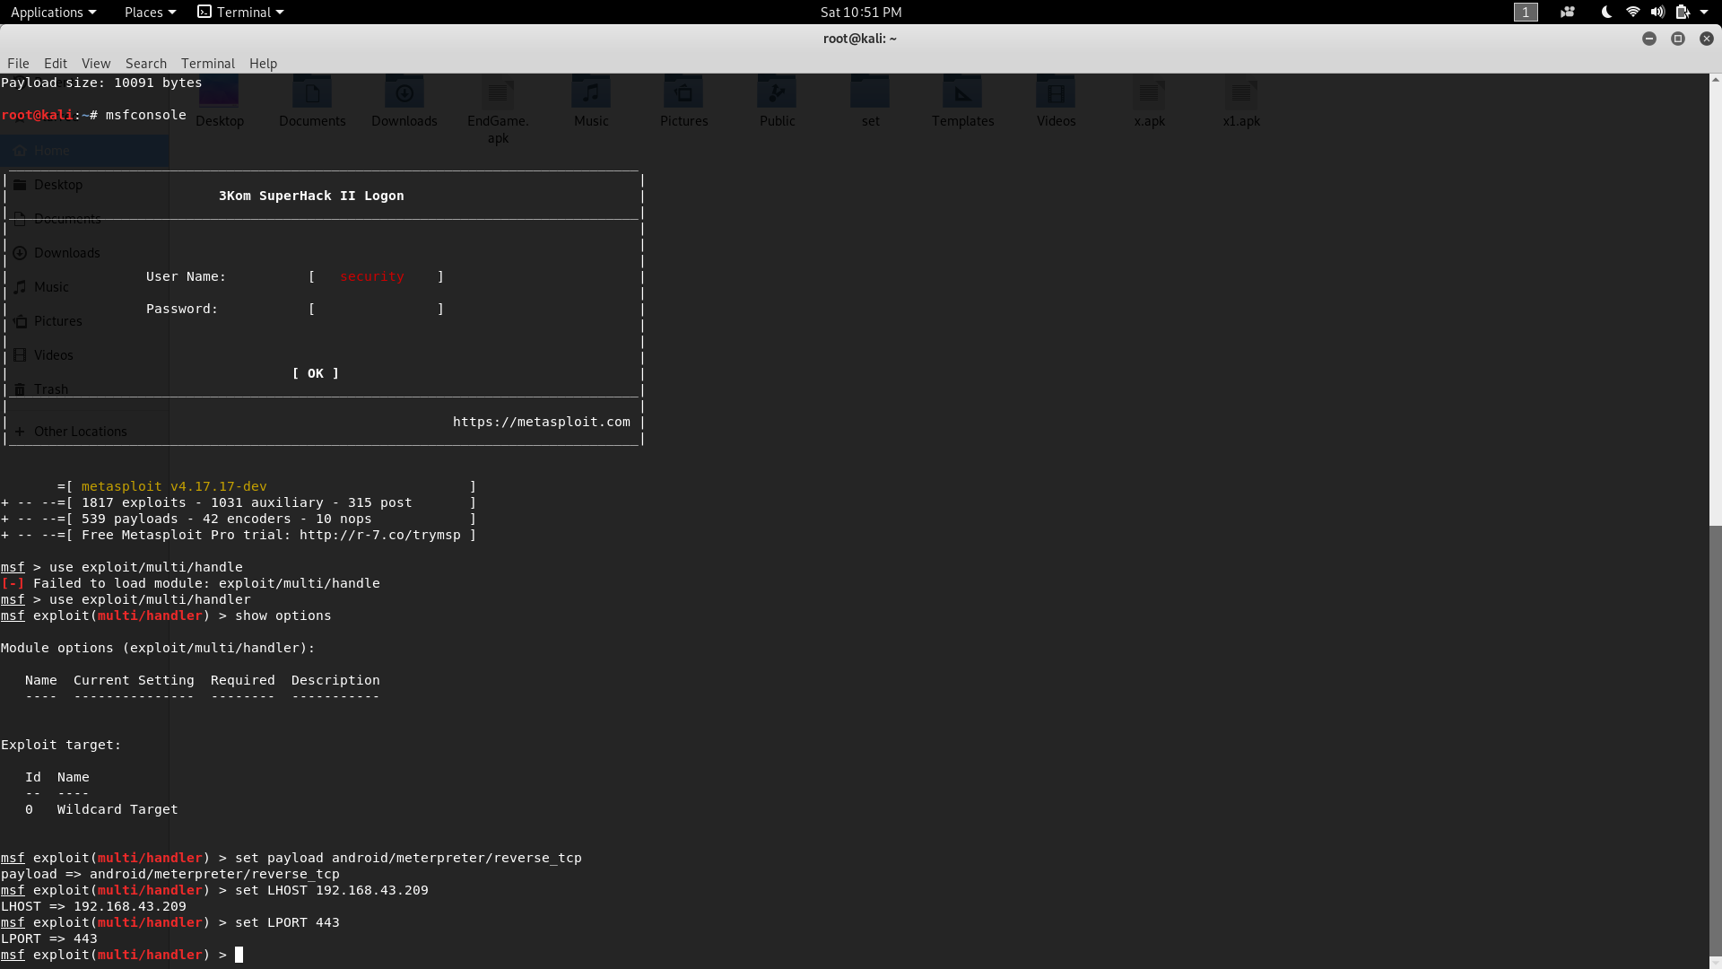
Metasploit
This is a ____
Firstly, we make the malicious payload
Then we use the metasploit console to make our server which the payload will connect after the user installs the application and runs it.
Server responds to it but in a way as the payload takes full access of your phone
Social engineering can be used
Loss of control
Loss of user data
More which you can add here

Slide 4
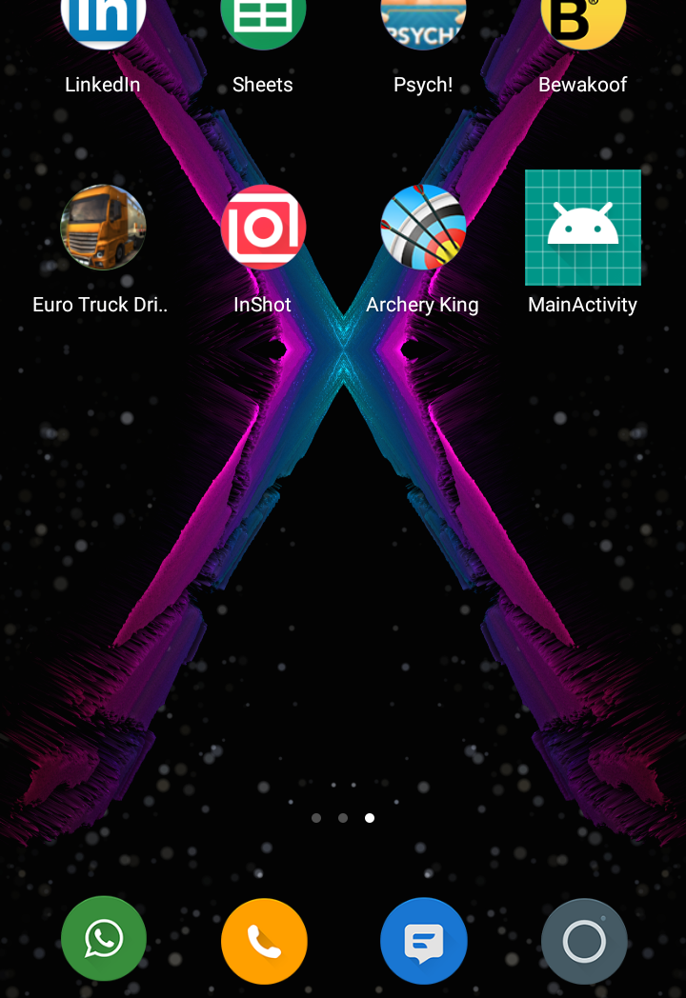
Malicious Application installed
Victim installs malicious app.

Slide 5
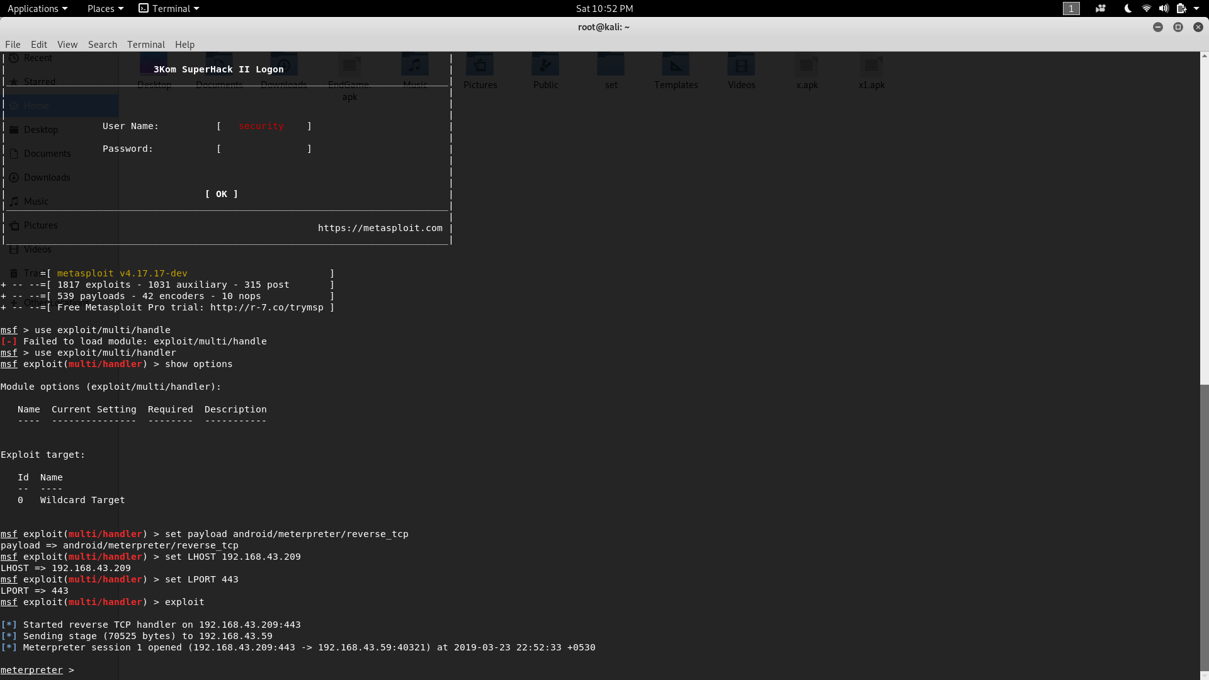
Getting Control of the Victim’s Android
Meterpreter is the command line interpreter of Metasploit, includes set of commands that controls Victim’s Android.

Slide 6
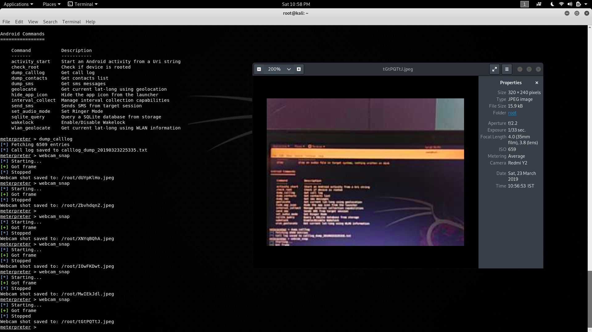
Getting access to Victim’s Android Camera
Without victim’s knowledge, their camera is compromised exposing whatever scene android is facing towards.

Slide 7
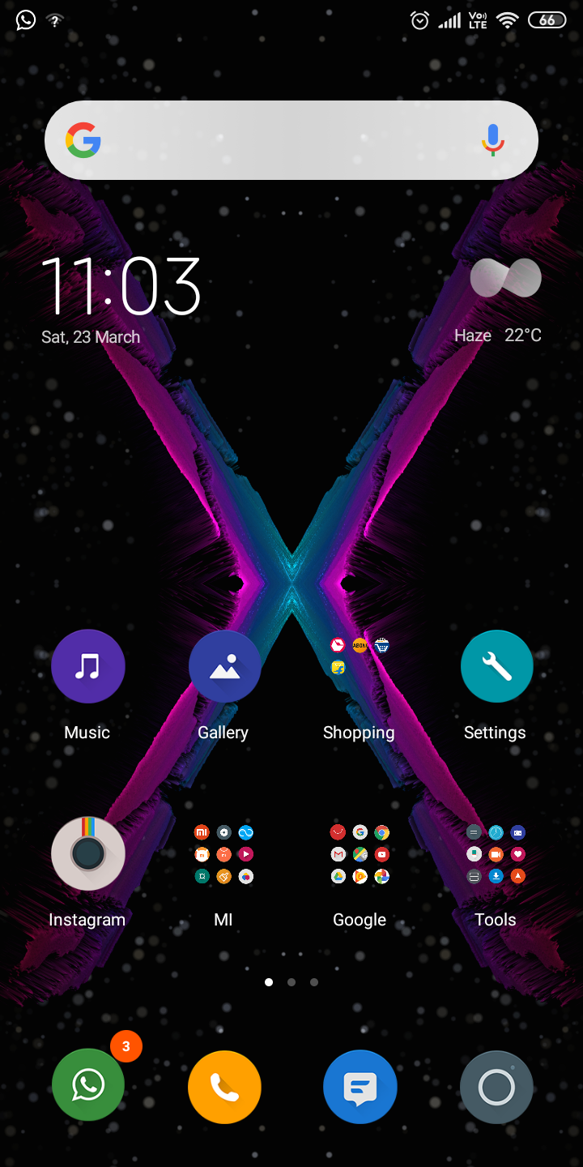
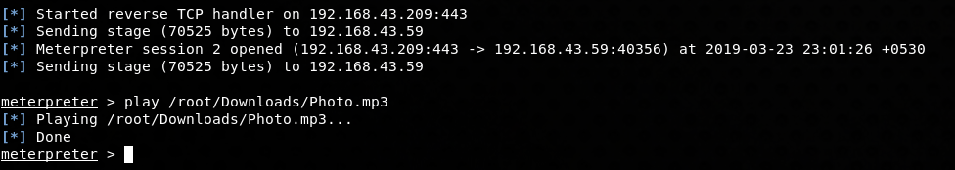
Playing Mp3 file on Victim’s Android.
Without any music player and in background.
This is victim’s Home-Screen

Slide 8
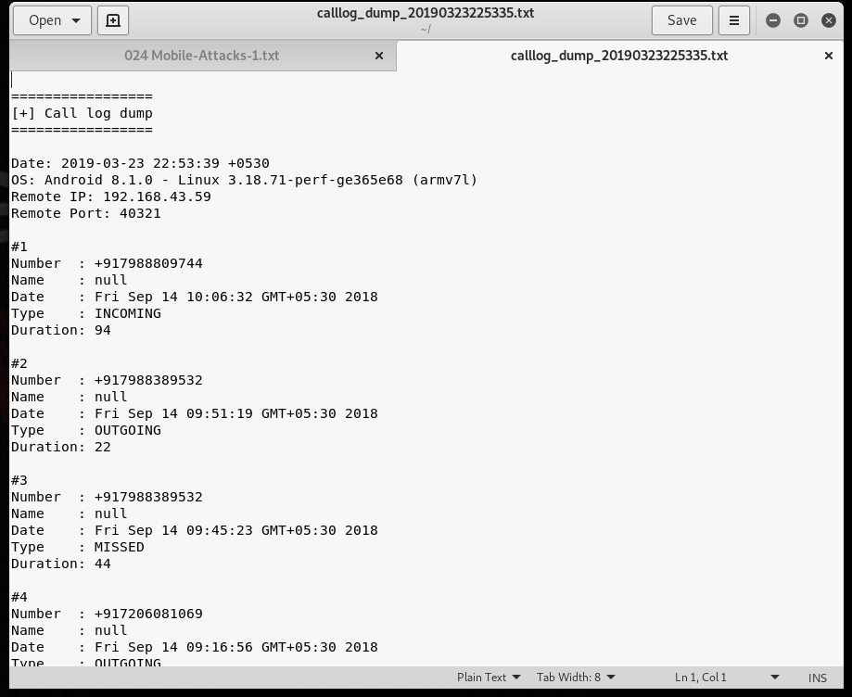
Victims Call record dumps
Full access to his call records and message records and more….

Slide 9
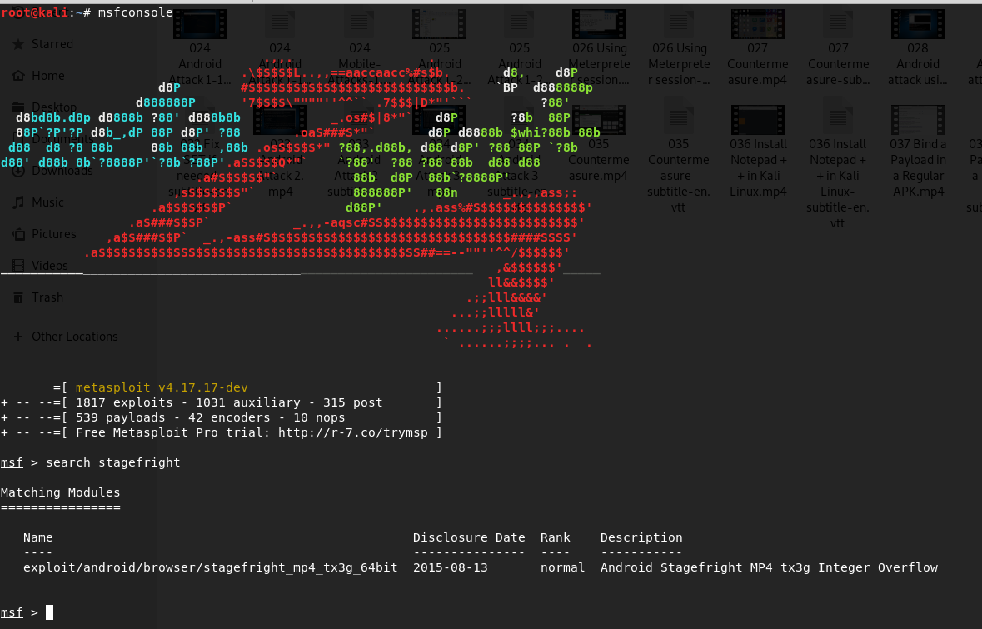
Stagefright Integer Overflow
Attack over the Android
Classified: can only be used with Stock Android . Hence not works with custom Android.

Slide 10
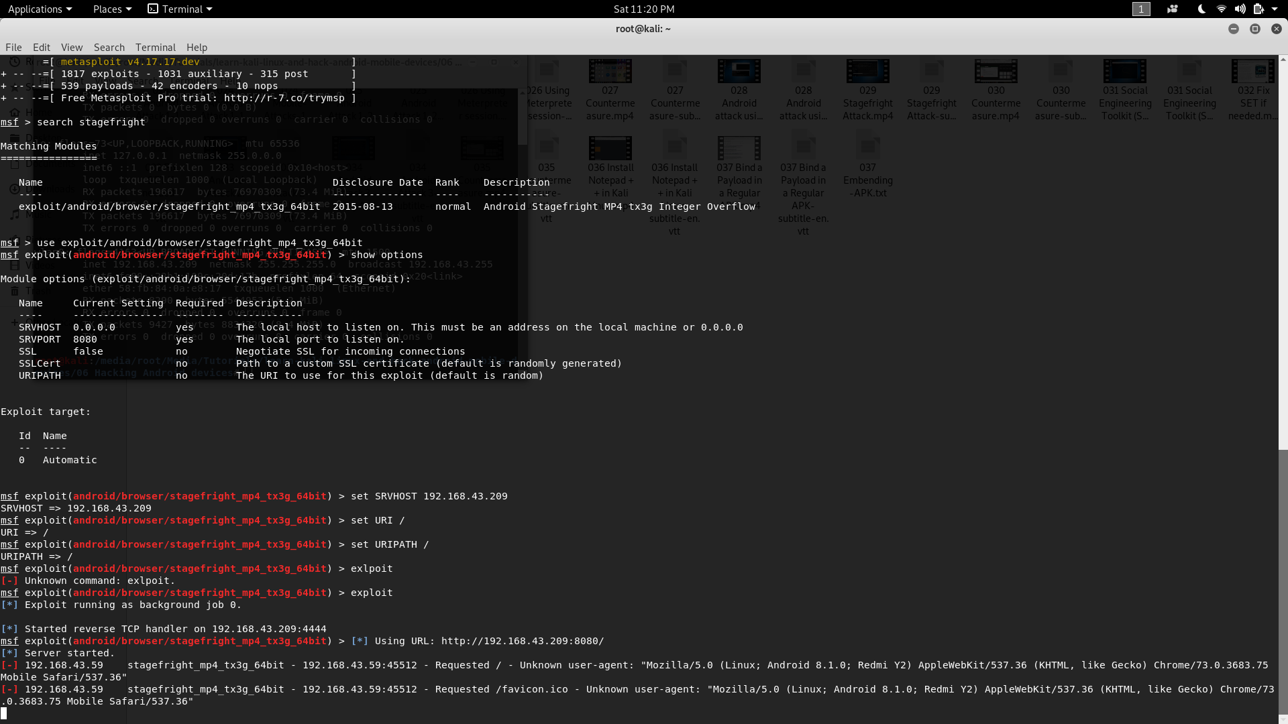
Setup Server
for Stagefright attack
Here, we set Host ID i.e. where the compromised data is returned listening on the default port 8080.

Slide 11
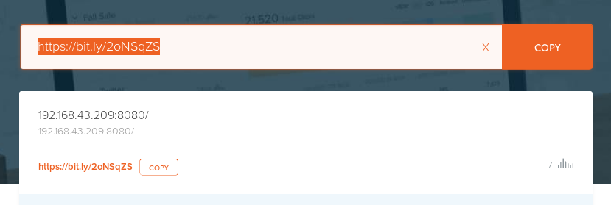

Slide 12

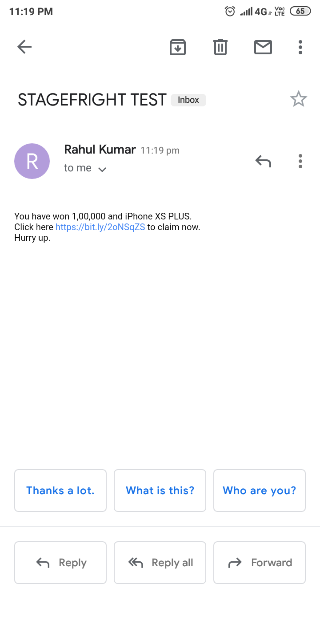
Incomplete slide
Shalini ka kam

Slide 13
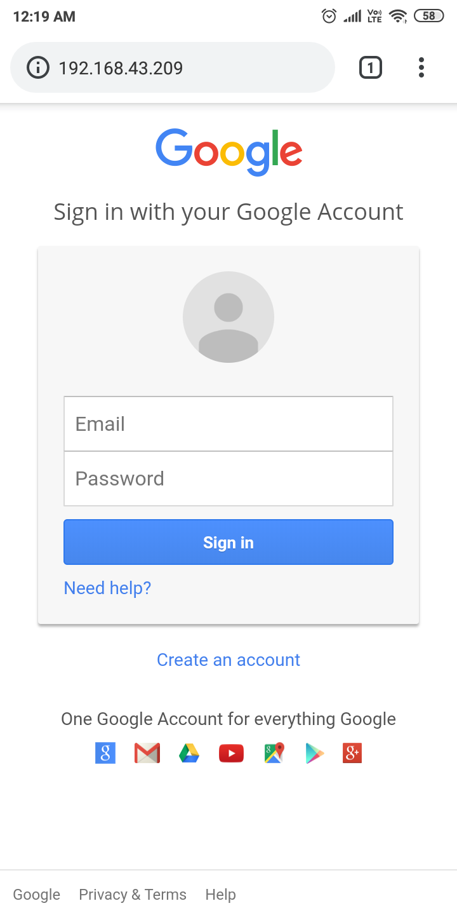
Credential Harvest Attack
Using the Social Engineering Toolkit
Google fake login page to harvest the Victims credentials….
Vicitm’s easily compromised….

Slide 14
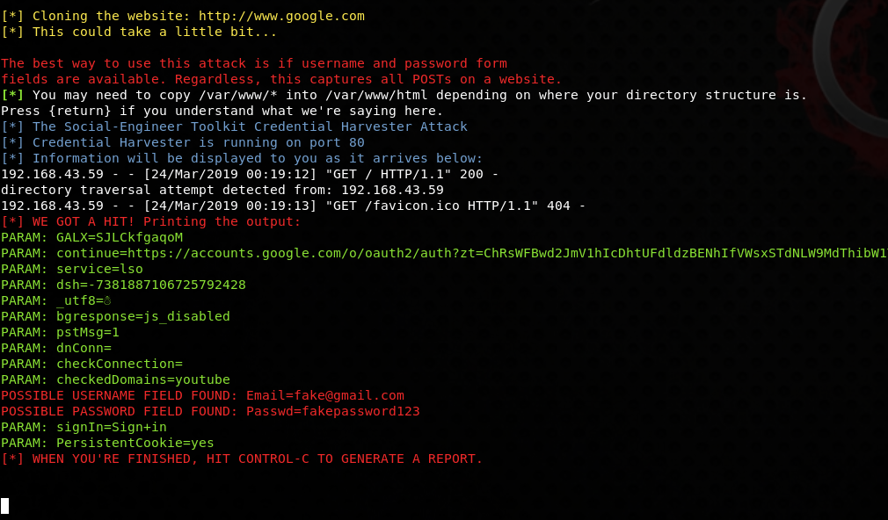
Request sent by the browser is captured.
Victim is redirected to a legit web-page so that they are not aware of the exploitation

Slide 15
This was our progress till now.
We are further working on below topics :
How to Embed the Malicious Payload in Legitimate App so as to trick the victim.

